Slide 1
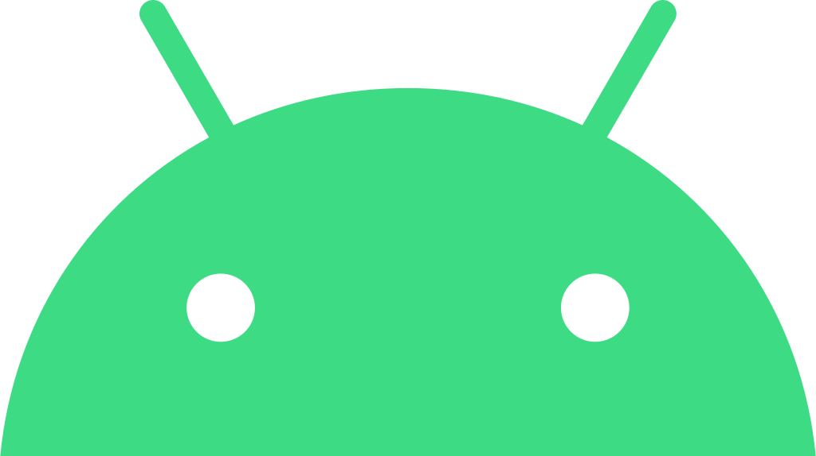
HARMONY
By: Prisha and Maria

Slide 2
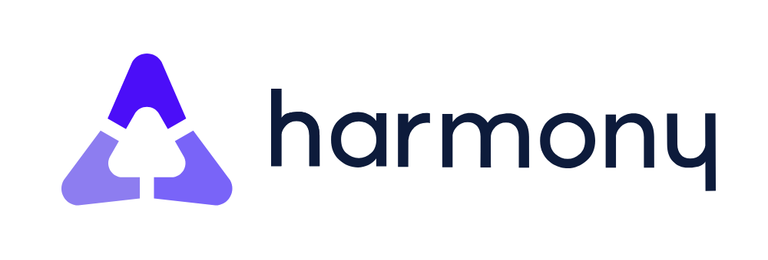
Early Software
The original Harmony Remote software was web-based and required an internet connection to download remote control codes.

Slide 3

My Harmony App
In 2010, Logitech introduced the "My Harmony" app, replacing the original software for newer remote models

Slide 4
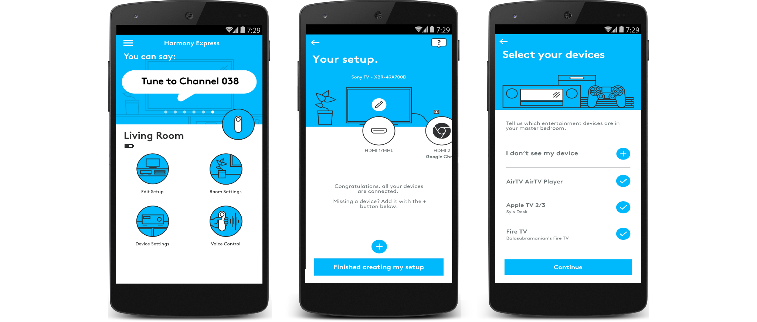
End of Support
Logitech ended support for the original Harmony Remote software on May 28, 2025, meaning older remotes can no longer be reprogrammed using that software, according to Logitech's website

Slide 5
Hub-Based Remotes
Hub-based Harmony remotes use the MyHarmony app for setup and configuration
It's important to note that the name "Harmony" is used by several different companies. Other companies with the name "Harmony" and their founding dates include:
Harmony Innovations, founded in 2006.
Harmony Legal Start-Up Company, founded at an unspecified time, but after the law firm hired Allebrum to build a custom solution.
Harmony (Biotechnology), founded in 2018.
HarmonyAI, founded in 2023.
Harmony (Construction), founded in 2019.
Harmony (software), founded in 2010

Slide 6
What happened after the end of support
For those using Logitech Harmony remotes that relied on the Harmony Remote software, the end of support in May 2025 means that you will no longer be able to:
Reprogram the remote: This includes making changes to device configurations, adding new devices, or modifying activities.
Create new accounts or access existing accounts: This effectively locks down the remote to its current programming.
However, it's important to understand what still works:
Existing functionality remains: The remote will continue to function with its current programmed settings and activities.

Slide 7
Fun Facts
End of success happened May 28, 2025
Harmony has not necessarily failed.
The slime guy is our favorite character.
Harmony is still thinking about to bring back the remote.

